Slide 1
11.4
Released 10th of March
Notes:
Hi there! My name is XXXX and I will tell you all a bit about the latest & greatest from the openSUSE Community, openSUSE 11.4!

Slide 2
Tumbling
and
Rolling
YOUR
own
build
Notes:
This release came out in the beginning of March and featured a bunch of cool things. We were the first to ship a stable LibreOffice in a major distro release; the same with Firefox 4.0, Scribus 1.4 and KDE SC 4.6. Yes, openSUSE is stable but also on the edge!
We also introduced Tumbleweed, a rolling release on top of openSUSE. Packman has updated their repository layout and of course you can use 11.4 from SUSE Studio!

Slide 3
Deeper
Down
systemd
Kernel 2.6.37
Zypper
ATI/NVIDIA
YaST Encryption
Notes:
Zypper package management super fast: downloads 'delta' (difference between old and new package) from different servers at same time!
YaST can handle fully encrypted system during installation
Kernel 2.6.37 supports Broadcom WIFI (many laptops have this chip) and there is better support for NVIDIA and AMD/ATI videocards.
Also, openSUSE has added some extra peformance patches to the kernel.
11.4 starts up faster and includes experimental GRUB2 & systemd

Slide 4




CHOICE
is
GOOD
Notes:
Let's begin by talking about desktop.
openSUSE believes you are not stupid. We believe choice and flexibility are good. So while we try to keep things as easy as possible, we don't go any further than that. Choose a default or adapt it to your personal needs.
We ship 4 major desktops: KDE, GNOME, XFCE and LXDE. Pick!

Slide 5
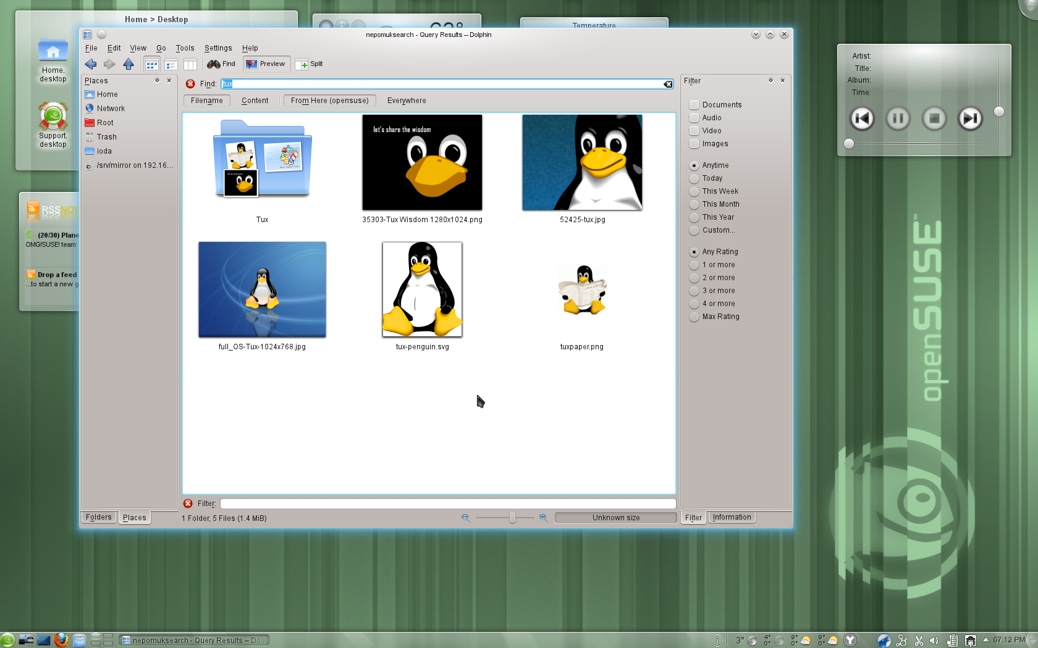
Notes:
Plasma Desktop has seen significant work on the Activities system, making it easy to associate applications with particular activities such as work or home tasks. This will allow you to easily manage different tasks and more quickly switch between them. Activities make use of session management, starting and stopping applications based on the active activity and showing windows depending on what you are doing.
Other stuff:
Revised power management
KWin new scripting language.
(find more info on en.opensuse.org/Feature_guide )

Slide 6
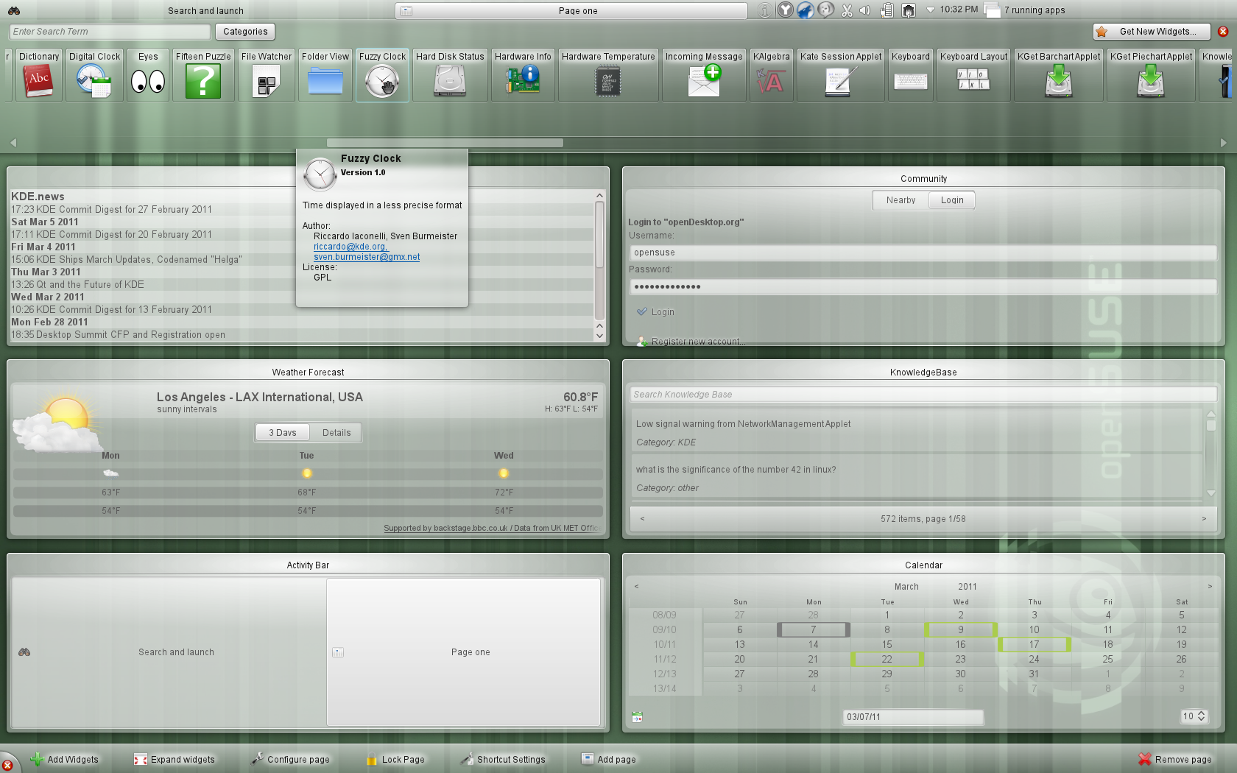
Notes:
Plasma Netbook, KDE’s workspace optimized for mobile computing devices has seen many speed enhancements and if you have a touch screen you’ll notice this workspace has become easier to use.

Slide 7
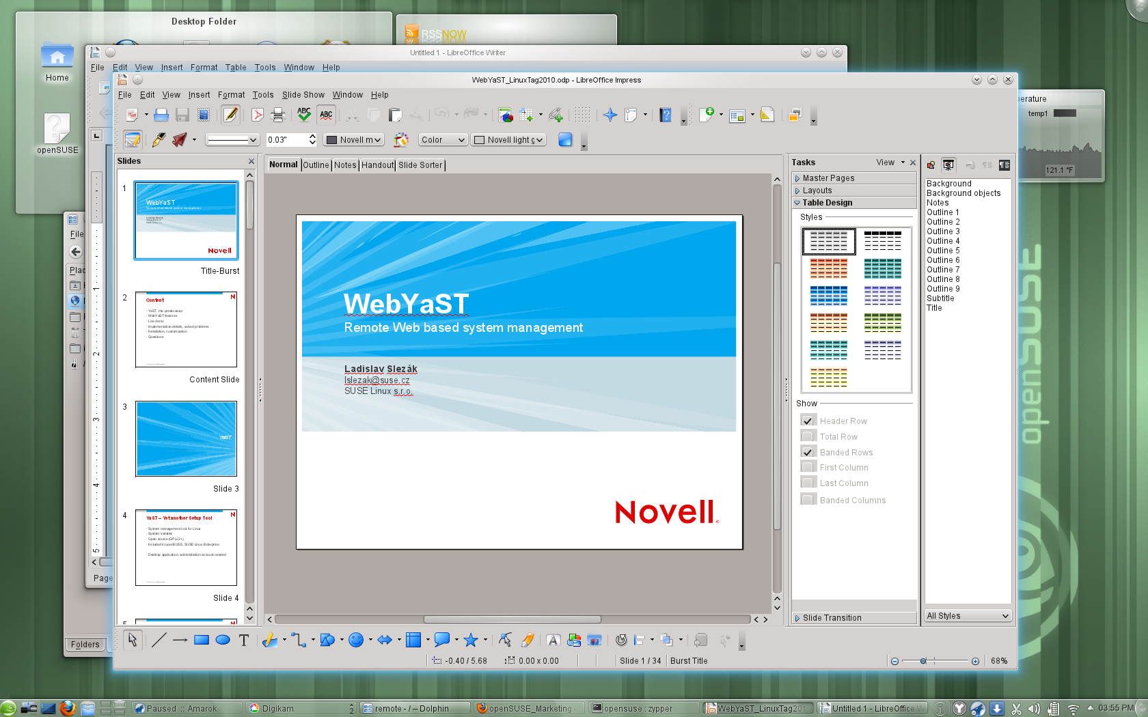
Notes:
The KDE team in openSUSE worked on integrating KDE. improved Firefox and LibreOffice integration: native filedialogs and notifications; they will use your default email client and browser. The new oxygen-gtk theme is defautl for GNOME applications running in a Plasma Workspace session

Slide 8
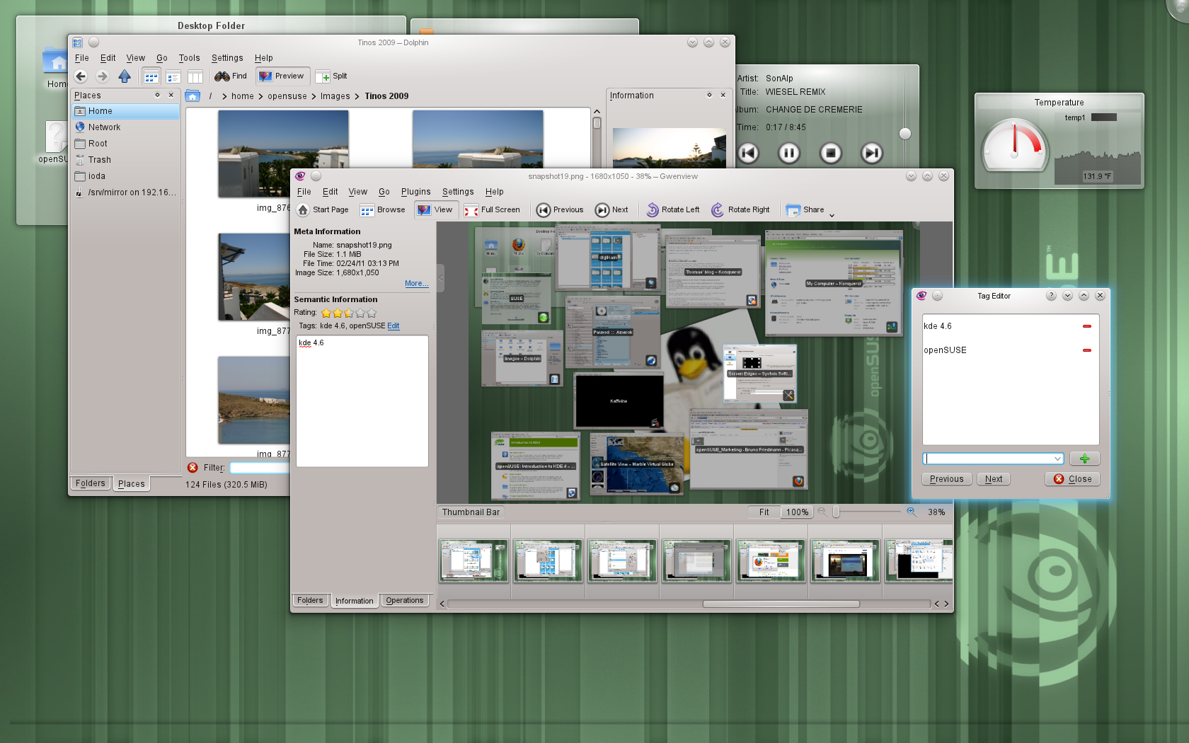
Notes:
Other improvements in KDE applications:
faceted search in Dolphin, the social sharing plugins like Flickr, Facebook and Picasaweb are now easy to reach from Gwenview and several applications.
Other improvements include the introduction of a backuptool for Nepomuk and significant improvements to the Bluetooth support with the introduction of BlueDevil, bringing easy wizards for device pairing and file browsing integration to KDE applications

Slide 9
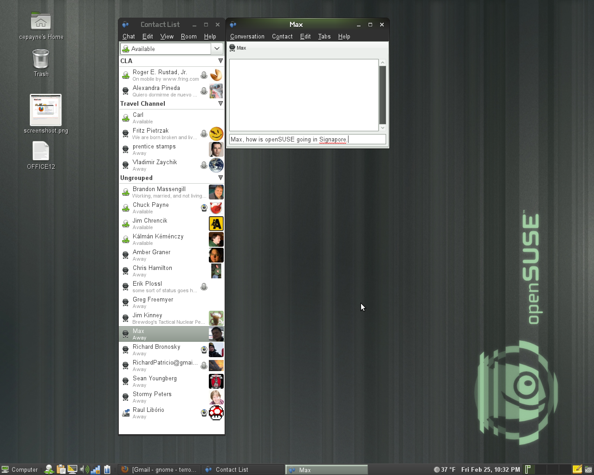
Notes:
- Updates to Empathy include user contact grouping with metacontacts, logging of chat records, and security certificate import.

Slide 10
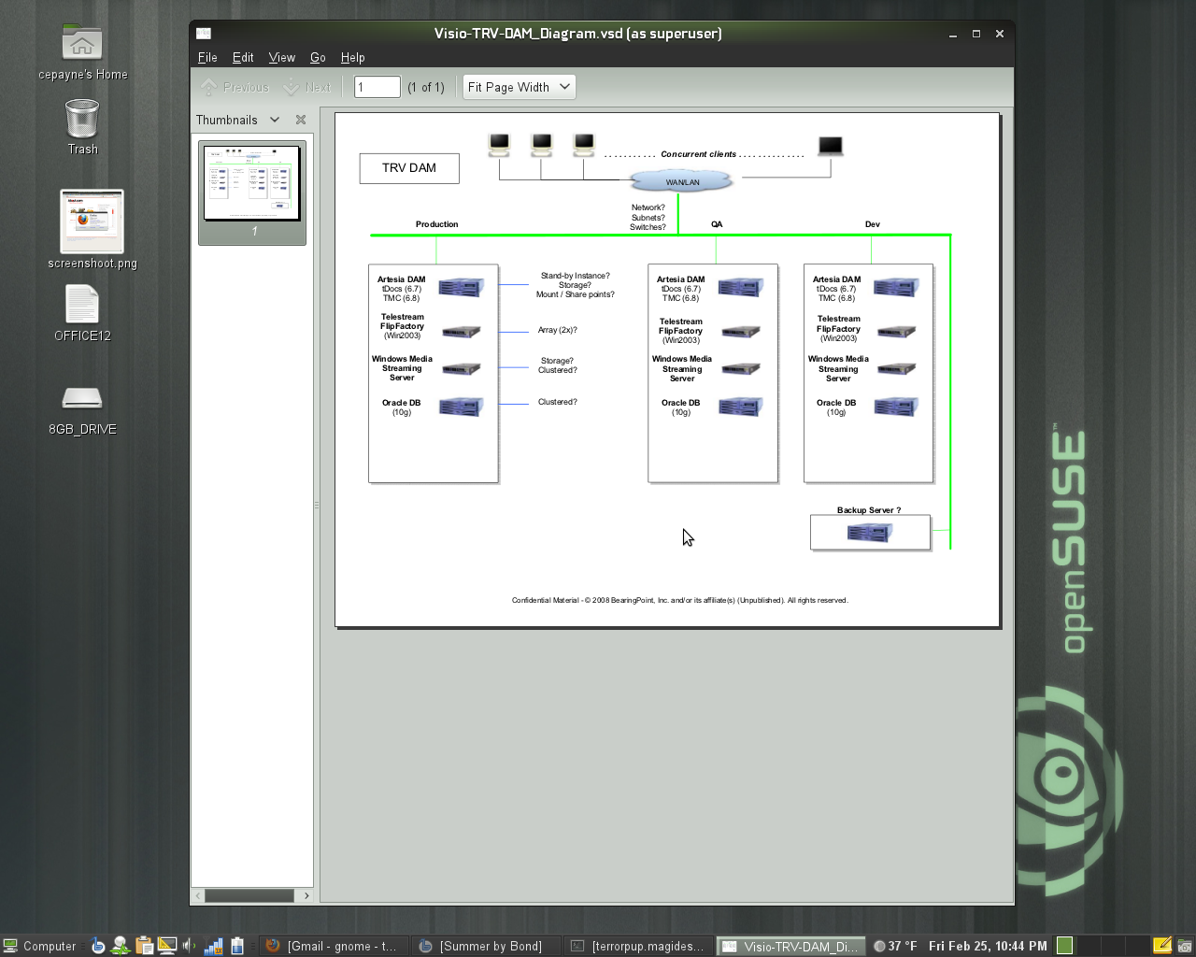
Notes:
- The Evince document viewer has improved accessibility support, maximum zoom level increased. Better Annotation support, add annotations from the side panel, change the default properties including author, color, transparency and more.
- Mousetweaks, which makes it easier to use a mouse for those users who may have limited mobility, has updated documentation

Slide 11
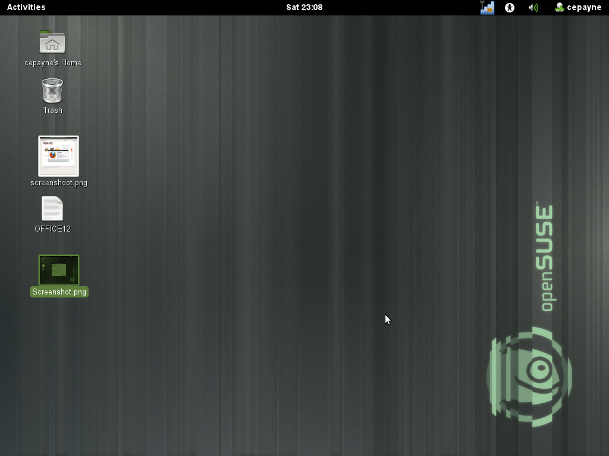
Notes:
GNOME 3.x Desktop (GNOME Shell)
GNOME Shell is the new face of GNOME. The goal of the project is to create a better design for the look and feel of the desktop and the key functions the desktop provides. These functions include enabling the user to find and open applications and documents, switch between various activities, and view incoming information such as chat messages or stock price updates.

Slide 12
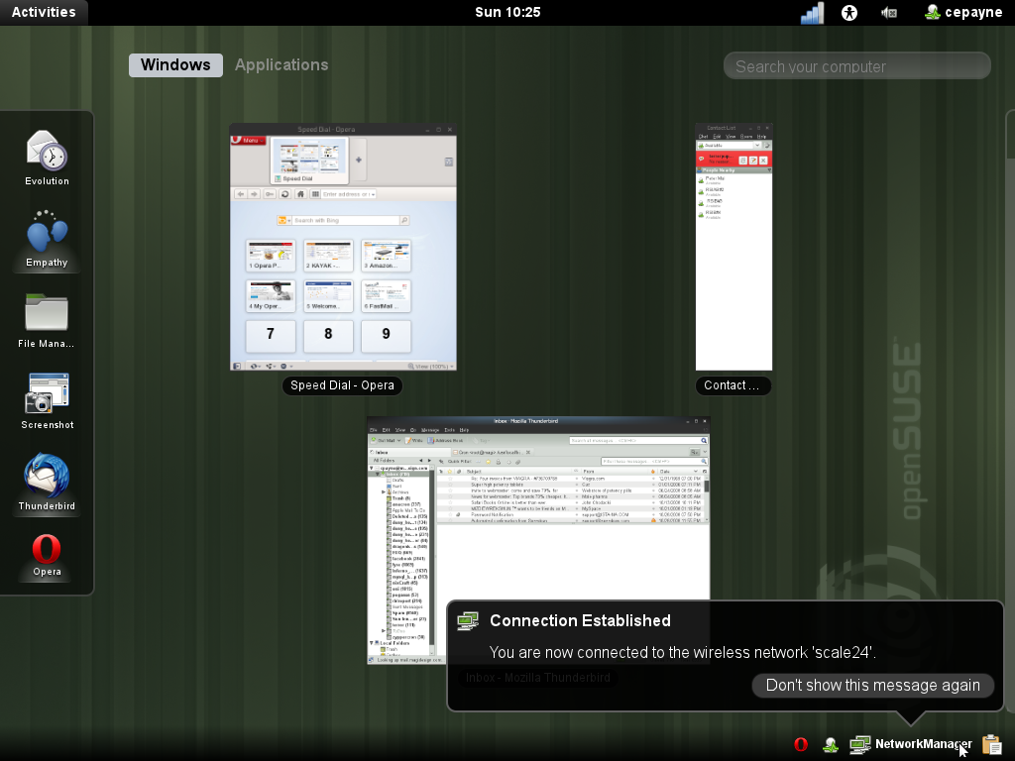
Notes:
If you click the 'Activities' button on the top left of GNOME Shell, you'll get this overview of your running applications.
You can start new apps by clicking them on the left. Notifications are on the bottom right, as you see. You will be able to respond to things like chat there right away without starting a separate application!

Slide 13
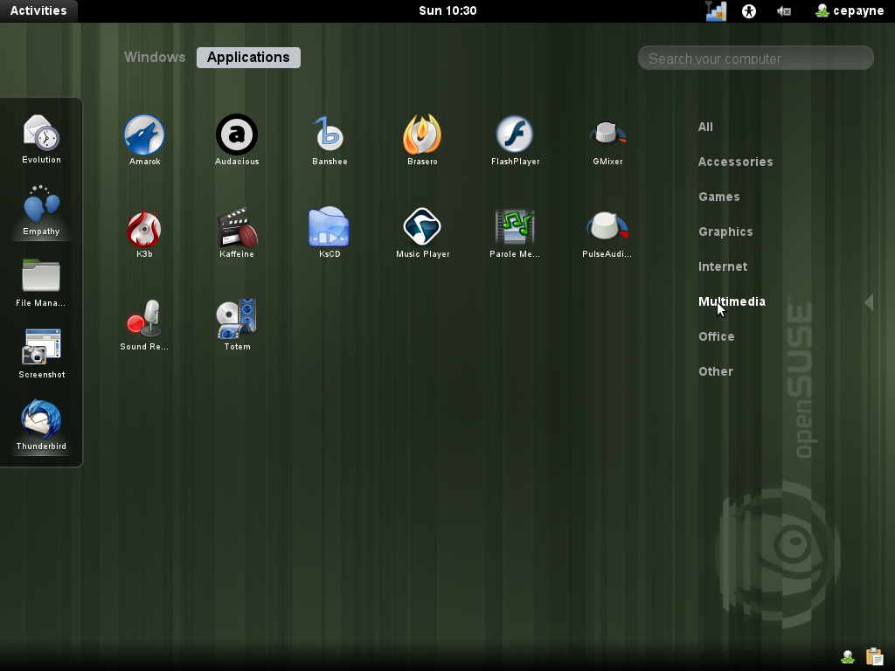
Notes:
If you use the search box you'll see GNOME Shell show you the apps you are looking for.

Slide 14
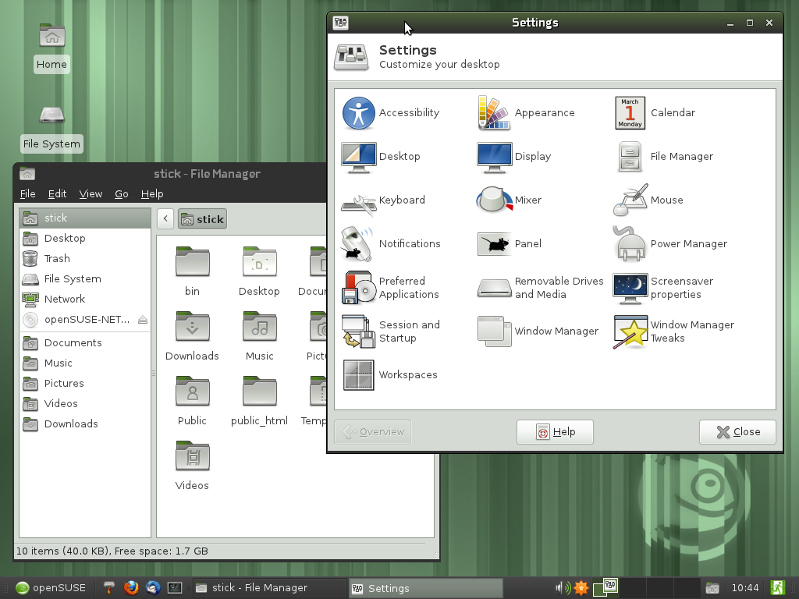
Notes:
There is more than KDE and GNOME. XFCE 4.8 is one of the 4 officially supported desktops on openSUSE. This release brings a better Thunar filebrowser which can work with FTP, Samba and other remote protocols. And it doesn't bother you with 100 different file copy dialogs but puts them all in one window! The Panel has been rewritten and is much easier to place and change with the editor or just via drag and drop.
OpenSUSE integration is excellent with improved shortcuts and file associations

Slide 15
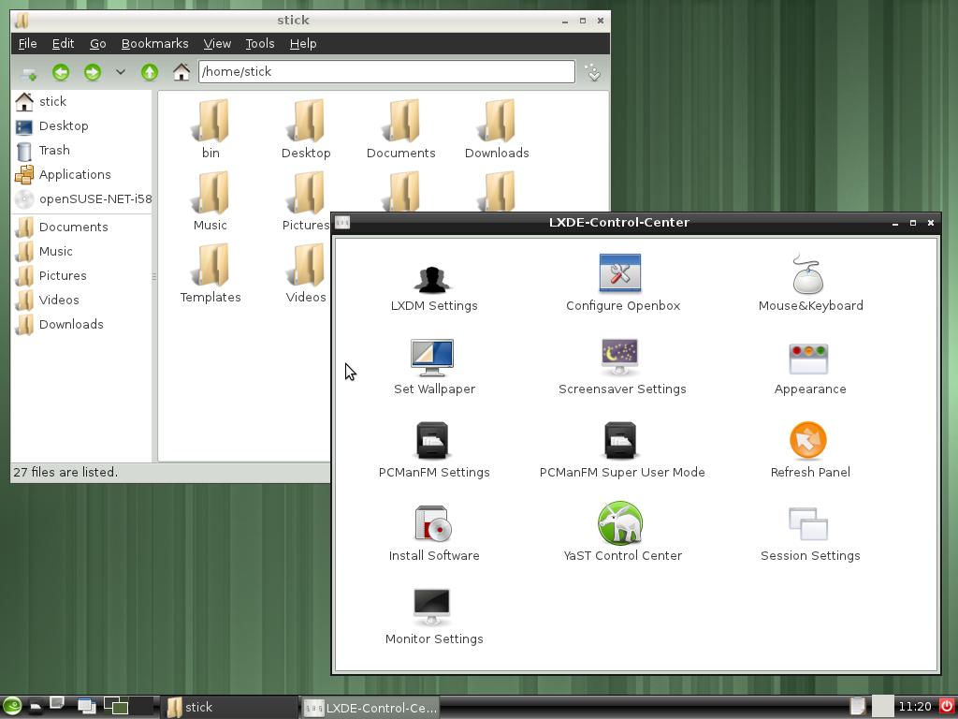
Notes:
LXDE aims to provide an extremely lightweight desktop, and succeeds on openSUSE 11.4. Booting in as little as 114MB of RAM, this GTK+ desktop provides a complete desktop experience without requiring modern hardware. The current release of LXDE in openSUSE introduces a number of smaller usability and stability fixes. Moreover, the LXDE team has worked on further integration in openSUSE, improving the menu, file associations and theming.

Slide 16
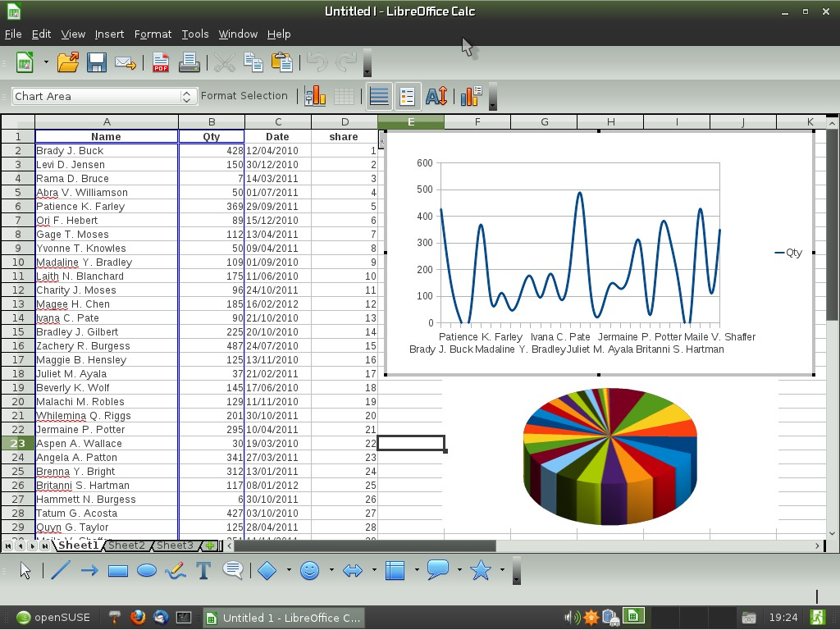
Notes:
LibreOffice 3.3.1 on XFCE 4.8 (SVG files in Draw, 1 million rows in Calc but real feature is community – Novell supports it heavily, openSUSE devs work on good integration!)
Koffice 2.3.1 Kpresenter: new slide sorter view and a shape animations tool. You can generate OpenDocument reports in KPlato and Kexi thanks to the KoReport library. OpenDocument support (esp text rendering) has been improved and also better support for reading MS files (doc, xls, ppt, docx, xlsx, pptx).

Slide 17
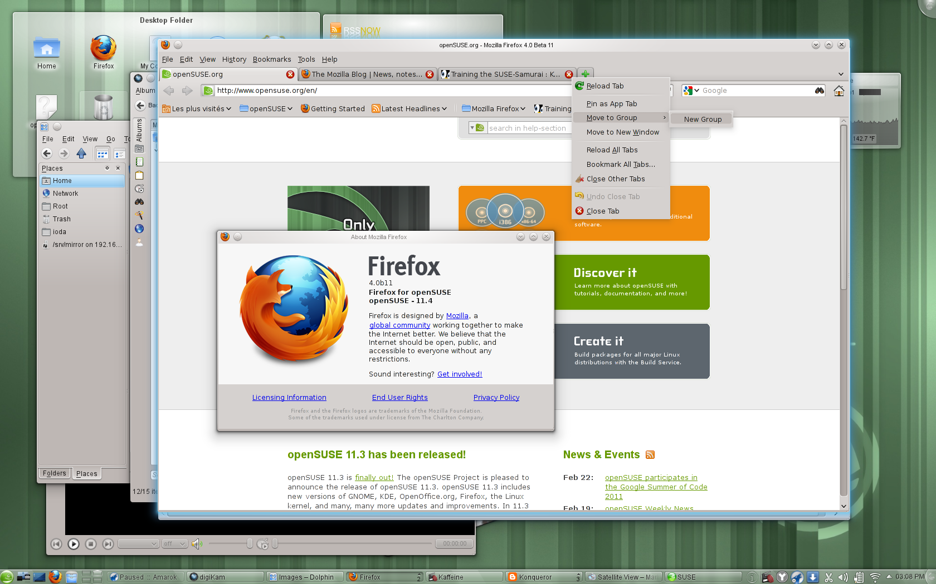
Notes:
Firefox 4.0 – new UI, better performance, Sync between Firefoxes
Other browsers – Google Chromium, Konqueror and ReKonq, Opera easy to install and others. Remember, choice!

Slide 18
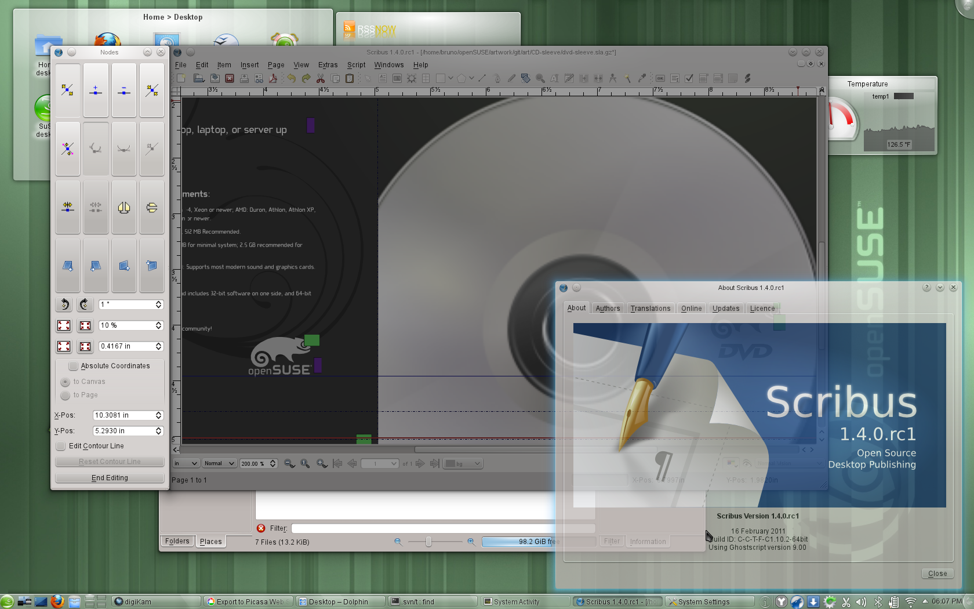
Notes:
Scribus 1.4.0 – Major rewrite, 1,5 year of work. Rewritten canvas (cairo), update to Qt4, usability.
Inkscape 0.48
* multipath editing
* improved text tool: subscript, superscript, numerical input for text kerning, tracking and more
* new Airbrush tool
* LaTeX export with PDF/PS/EPS
Krita 2.3 enduser ready. New features: brush settings presets, canvas rotation, warp transform, new color selector & new brush engines.

Slide 19
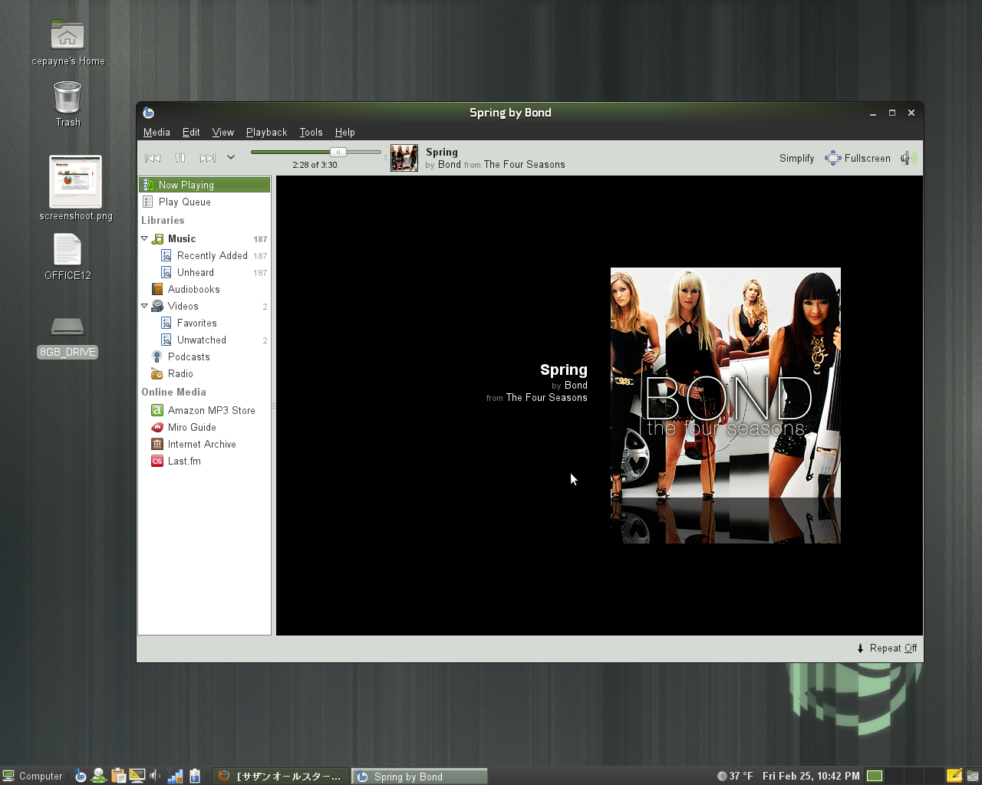
Notes:
Multimedia apps:
Media player Banshee 1.9.3 Now Playing simplify mode, play queue shuffle action, better downloading of cover art, MusicBrainz ID support and improved Last.FM integration. Finally, device support has been improved a lot. Among others, Banshee works more smoothly with the Droid X, Galaxy Portal, Xperia X10, Maemo and MTP devices in general.

Slide 20
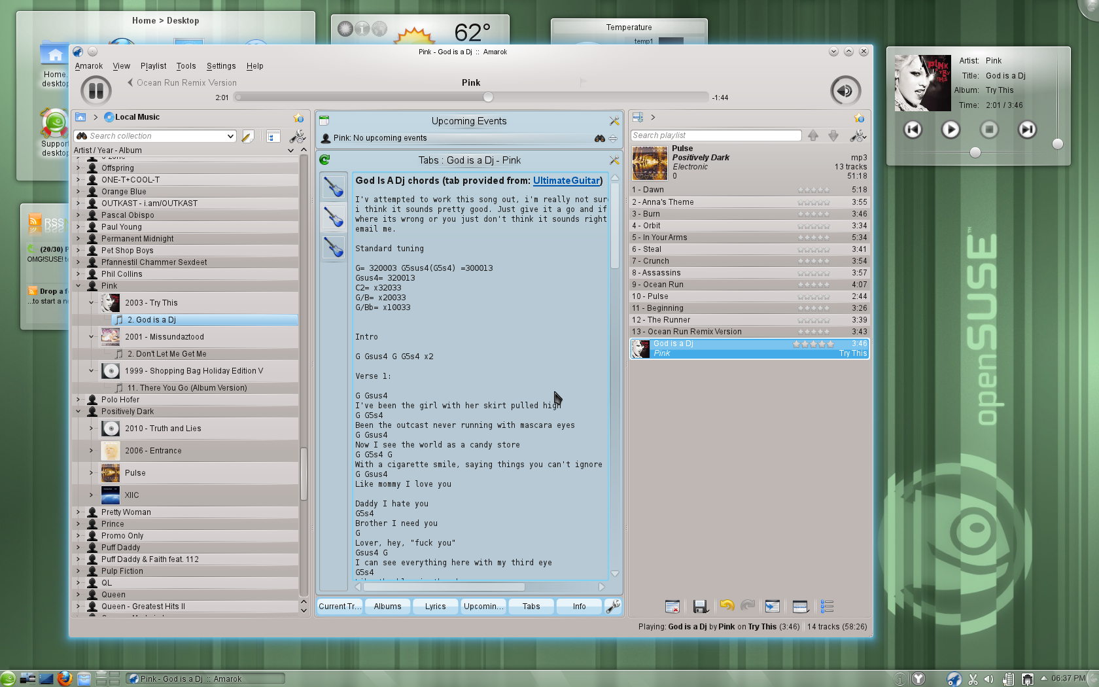
Notes:
Amarok 2.4.0 is faster, write to audio files, MusicBrainz tag retrieval, Guitar and Bass tab fetching, upcoming events, UpnP.
Rhythmbox 0.13.3 “Country Rain”: new context tab showing links to relevant websites with music info.
Clementine: new information panes show lyrics, song statistics, artist biographies, photos and lists of tags and similar artists. added ratings, play counts and skip counts. You can create smart and dynamic playlists from songs in your library, and also now listen to music from Jamendo and Icecast radio stations.
As usual: K3B, Brasero, Audacity and more are in 11.4!

Slide 21
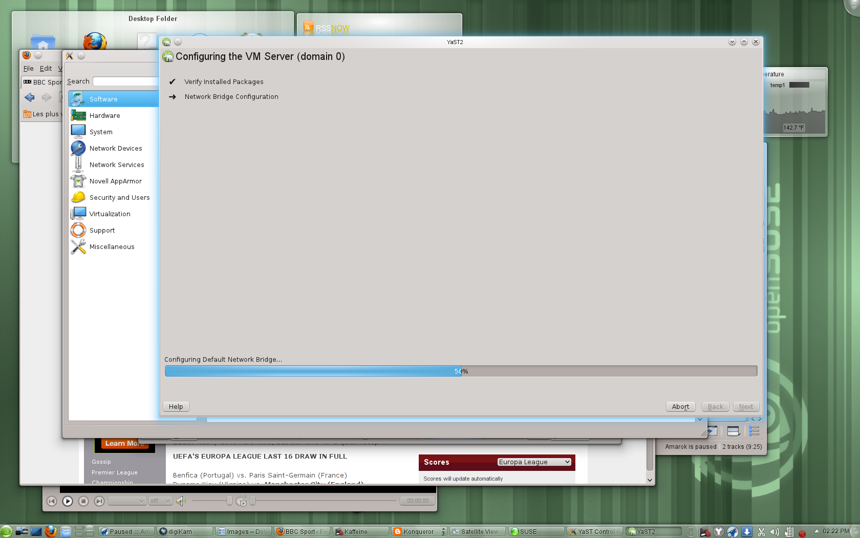
Notes:
openSUSE is great for virtualization. YaST makes management easy!
latest Xen, VirtualBox and KVM and integration with VMware and HyperV.
Xen: memory overcommit, Vmware workstation player/driver
Virtualbox: VMDK, VHD, and Parallels images supported, VHD and VDI can be resized; 32bit systems can use more than 2 GB of ram.
Introduction of open-vm-tools and virtualbox-guest-tools for easier management.

Slide 22

Notes:
Sysadmins will appreciate openSUSE. YaST was awesome but now: WebYaST! All the power of YaST over a RESTful webservice, easy to use!
Network tools like WireShark 1.4, SMB Trafic Analyzer and everything for webservers:
Apache, lighttpd, Tomcat, nginx
MySQL, PostGRESQL, SQLite, MariaDB
Latest High Availability Clustering tools
New documentation on VMs, tuning etc

Slide 23
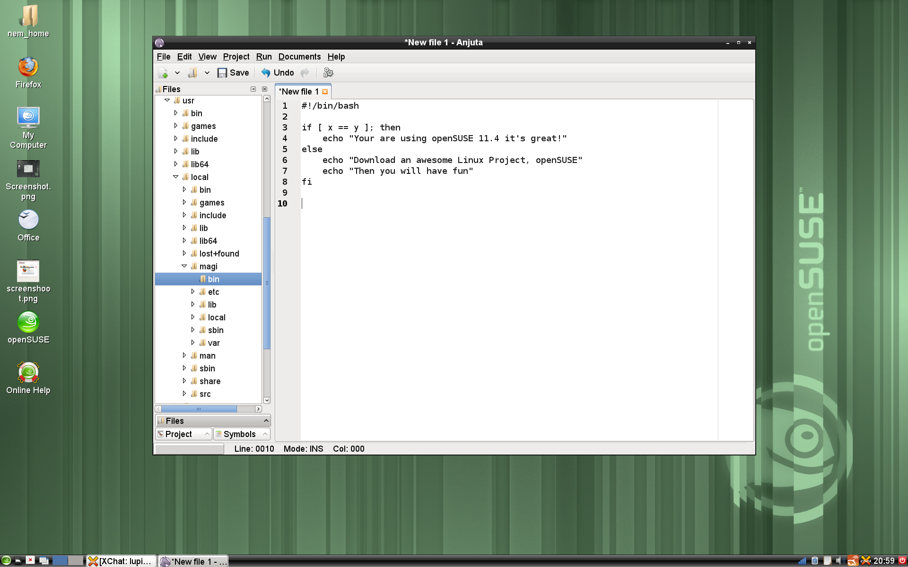
Notes:
OpenSUSE 11.4 is great for developers. We ship pretty much all IDE's (Anjuta, Geany, QtCreator, MonoDevelop, KDevelop, Eric, CodeBeans etc) but also the latest KDE & Qt, GNOME 2.x AND 3.x libraries and GTK as well as Python, Ruby, Perl, Java and pretty much every other language.

Slide 24
Your next Linux Distribution!
Notes:
So, the question you should be asking is not “what does openSUSE have that I need?” but “what does openSUSE NOT have that I need?” and the answer is most likely: nothing. After all, our OBS provides well over 100.000 different packages made by over 25.000 people. All that you can get easily through Zypper and YaST! Moreover, you can use KIWI (or the web interface SUSE Studio) to build your own openSUSE based operating system. We have projects like Tumbleweed, Appstream and Bretzn – we do so much cool stuff it's hard to keep track of it.
In short, openSUSE is much more than a linux distribution. 11.4 is awesome, but thanks to the other things the openSUSE Project does, no other linux distro can beat it!
Thank you for listening.

